Slide 1
Fast Indexes and Algorithms for Set Similarity Selection Queries
Marios Hadjieleftheriou, Amit Chandel, Nick Koudas, Divesh Srivastava
Presented by Kyle Patterson, James Fitzpatrick

Slide 2
Introduction
Why?
Data Consistency
User Error
Significance to businesses
Set Similarity Versus String Similarity
No single comparison metric works across all domains
Paper Concentrates on Expanding TF/IDF Cosine Similarity and BM25

Slide 3
TF/IDF
TF – Term Frequency
Each token is weighted by the total number of times it appears in the multi-set
The more times the term occurs in a multiset (more common), the more weight given to it
In practice, the cardinality is so small that TF can be dropped without affecting the quality of the results
IDF – Inverse Document Frequency
The inverse of the total number of times a token appear in a database
The less a term occurs in the database (more rare), the more weight it has

Slide 4
Usefulness of TF/IDF
These metrics utilize properties of datasets
Most strings are unique
Few strings are shared between documents
Most strings have a small term frequency
Eliminate TF as TF/IDF is not much different than just IDF
Normalized Set Length
Similar Sets have Similar Lengths
An exact match will always have score = 1

Slide 5
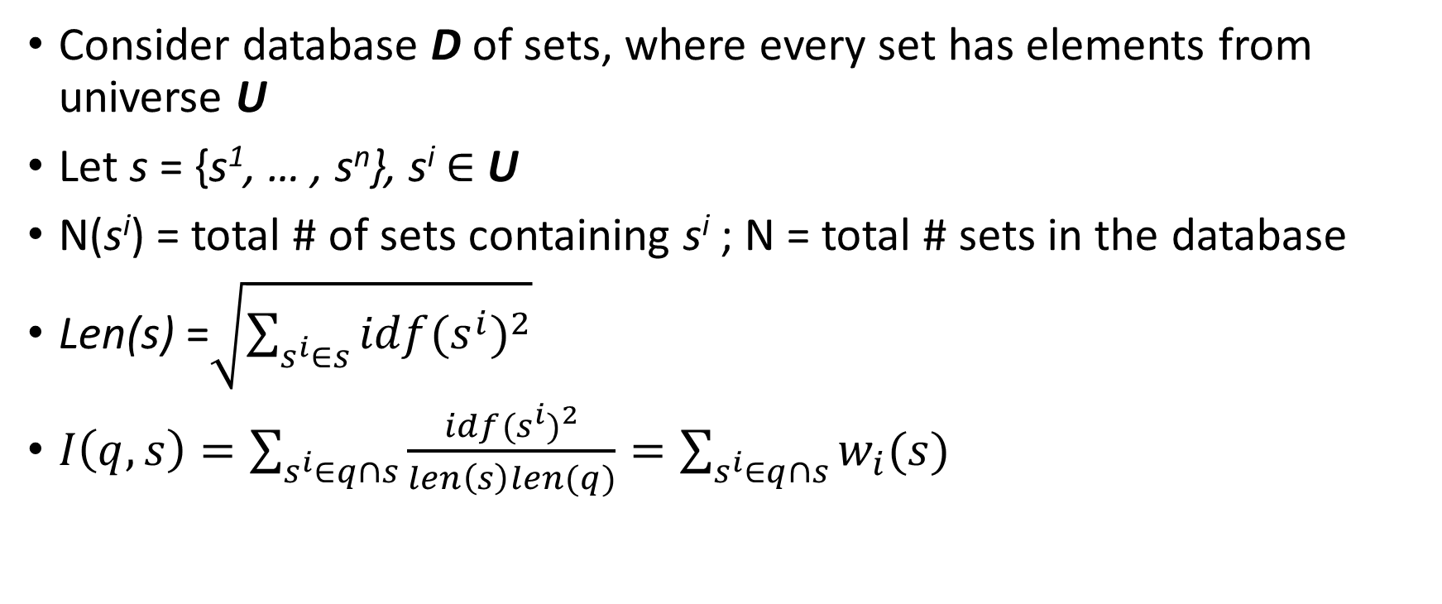
Formal definition
Consider database D of sets, where every set has elements from universe U
Let s = {s¹, … , s^{n}}, s^{i} ∈ U
N(s^{i}) = total # of sets containing s^{i} ; N = total # sets in the database
Len(s) =$\sqrt{\sum_{s^{i}∈s}{idf(s^{i})^{2}}}$
$I\left(q,s\right)=\sum_{s^{i}∈q∩s}{\frac{idf(s^{i})^{2}}{len\left(s\right)len(q)}=\sum_{s^{i}∈q∩s}{w_{i}(s)}}$

Slide 6
Existing Set Similarity Solutions
Relational Databases
Decompose String Sets into n-grams
Store locations/positions of grams
Inverted Lists
Specialized Index
Each gram is a index in the list

Slide 7
Existing Techniques – Relational Database
id | 4-gram | idf | Len
Main St Maine | Main | 7 | 31.7
Main St Maine | ain_ | 10 | 31.7
… | … | … | …
Main St Maine | aine | 6 | 31.7
Florham Park | Flor | 4 | 29.3
… | … | … | …
id | 4-gram | idf | len
Main Street | Main | 7 | 29.3
Main Street | ain_ | 10 | 29.3
… | … | … | …
Main Street | reet | 6 | 29.3
Base Table (4-grams)
Query
Using standard SQL processing (aggregate/group-by/join), we can evaluate the IDF similarity

Slide 8
Existing Techniques – Inverted List
7 |  |  | 10 |  |  | 15 |  |  | 13 |  | <-- idf
Main |  |  | ain_ |  |  | in_S |  |  | n_St |  | <-- 4-gram
2 | 3 |  | 1 | 1 |  | 1 | 1 |  | 3 | 5
3 | 5 |  | 3 | 5 |  | 5 | 10 |  | 5 | 10
5 | 10 |  | 6 | 2 |  | 10 | 1 |  | 6 | 2
9 | 4 |  | 7 | 7 |  |  |  |  | 12 | 5
11 | 3 |  | … |  |  |  |  |  | 17 | 3
… |  |  | 17 | 3
17 | 3
id | len
Similarity can be evaluated using a multi-way merge

Slide 9
But what if the lists are sorted by increasing order of lengths?
Implicitly, the sets are arranged in decreasing w_{i} order
Given that IDF is a monotonic score function, TA/NRA can compute the scores incrementally

Slide 10
Non Random Access (NRA) – “Breadth First”
For each q-gram in the query, create an inverted list <s, len(s)>
Sort these lists by token contribution in decreasing order
Search each q-gram in round-robin fashion
Pop the next (highest contribution) item for each q-gram
If s is not in the candidate set, add it to the candidate set
If s is in the candidate set, update its weight
If the weight of s is less than the threshold, and the sum of the frontier weights of the other q-grams

Slide 11
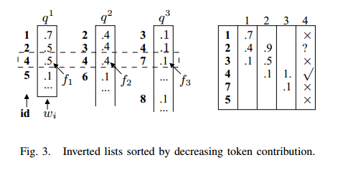
NRA - Example

Slide 12
Semantic Properties of IDF
Relational and NRA only take advantage of monotonicity property
Other properties include:
Order Preservation
For all k!= l, if w_{k}(s) <= w_{k}(r), then w_{l}(s)<= w_{l}(r)
Magnitude Boundedness
For any s and q, after retrieving len(s) from any list k, the best case upper bound can be computed directly
Length Boundedness

Slide 13
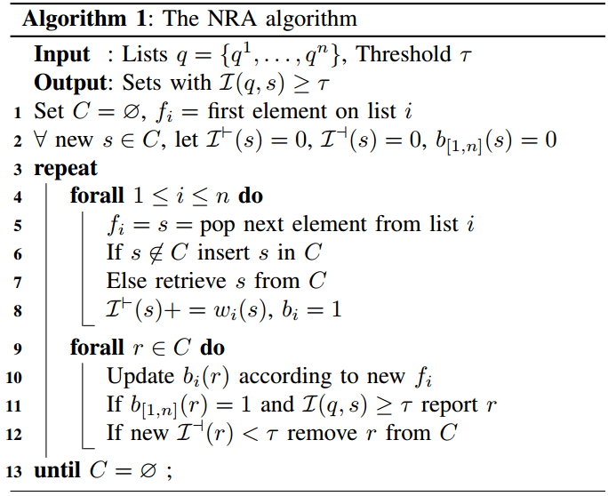
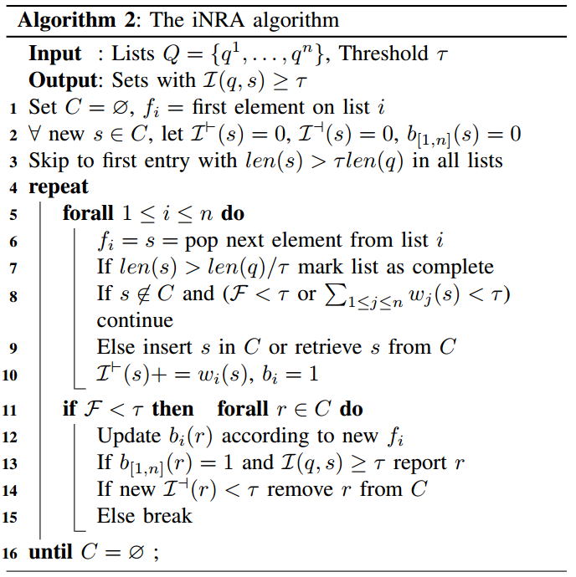
Improved Non Random Access (iNRA)

Slide 14
iNRA
Length Boundedness prunes scan space
If no index on length, follows NRA
Order Preservation to determine if given element is in a list
Magnitude Boundedness computes best case upper bound

Slide 15
Shortest-First Algorithm (SF)
If we view iNRA as a breadth first approach, then SF is a depth first approach
Skip to first entry in every list with length len(s) >= τ len(q)
Compute λ_{1….n}
Scan inverted lists in decreasing idf order
Tokens with higher idfs examined first
Occur in fewer strings
Smaller lists of strings that they occur in
Smallest chance of false positive candidates
Scan for elements of length from τ len(q) to min(len(q)/ τ, λ₁)
Store candidates in candidate set C

Slide 16
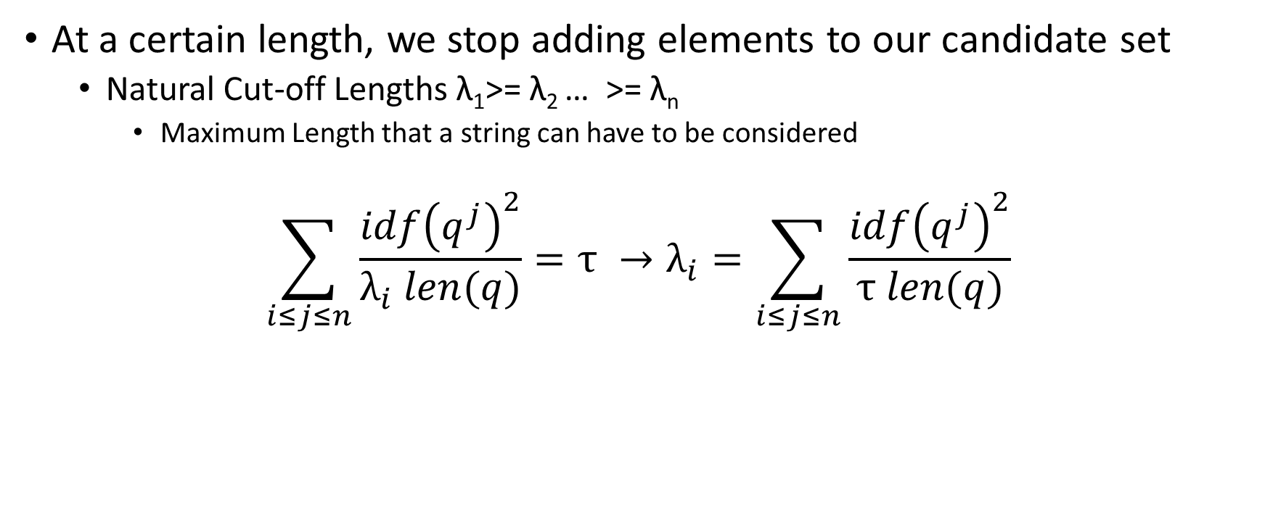
Shortest-First
At a certain length, we stop adding elements to our candidate set
Natural Cut-off Lengths λ₁>= λ₂ … >= λ_{n}
Maximum Length that a string can have to be considered
$$\sum_{i≤j≤n}{\frac{idf{\left(q^{j}\right)}^{2}}{λ_{i} len(q)}=τ →λ_{i}}=\sum_{i≤j≤n}{\frac{idf{\left(q^{j}\right)}^{2}}{τ len(q)}}$$

Slide 17
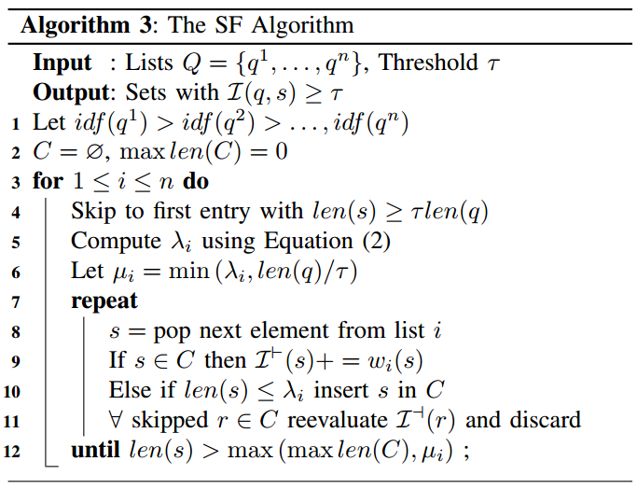
Shortest-First - Algorithm
Merge sort subsequent lists with the candidate lists.
Adjust the new list based on the subsequent λ values
As we search more subsequent list, the lengths of candidate strings will get shorter.
Continue until scores for each element in candidate set is calculated

Slide 18
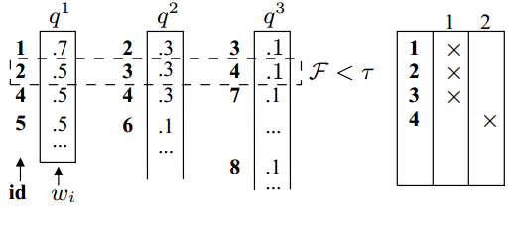
SF - Examples
In this case, iNRA is arbitrarily better than SF

Slide 19
Shortest-First - Performance
Average Case
Scans far fewer entries than iNRA
Most lists are pruned
Worst Case Scenario
Scans arbitrarily more entries than iNRA
Occurs with many long lists, low τ, and poor pruning lengths
Curious Case
If the τ = 1, then the search will only be done on string of the exact same length
In Practice, Bookkeeping costs of SF are very low

Slide 20
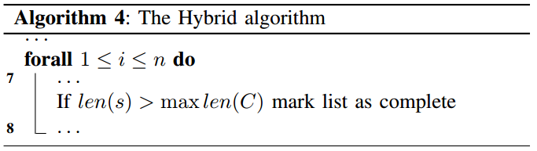
Hybrid Algorithm

Slide 21
Experimental Setup
Using IMDB and DBLP databases
Each word was broken down into 3-grams
Algorithms were evaluated according to
Processing cost
Pruning power
Storage efficiency

Slide 22
Experimental Results
Non-Composite Index Basic SQL query never terminated in reasonable time
Inverted Indexes
Multi-way Merge, TA/NRA
With and without skip lists
Total size of inverted lists 5GB
Extendible Hashing
3.2 GB
All indexing structures are significantly larger than dataset

Slide 23
Experimental Summary
SF is the winner in terms of
Computation Cost (due to low bookkeeping)
Index Size (Only uses inverted and skip lists)
Hybrid Algorithm has higher pruning power
More involved data structures increase computation cost

Slide 24
Conclusions
Similarity measures can be exploited in set similarity
Length Bounding
Many similarity search algorithms can benefit from Length Bounded pruning

